Slide 1
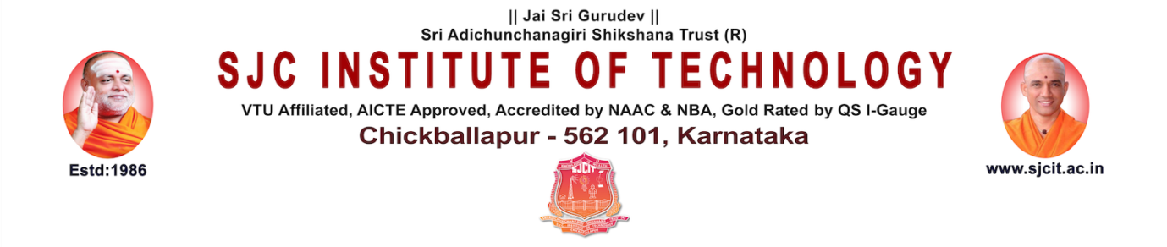
Python with Data SCience
Internship : Review
Presented By
Mareddy Charan 1SJ22AD024
Under the Guidance of
Badrinath K
Assistant Professor, Dept of AI&DS
SJC Institute of Technology

Slide 2

Python with Data Science
Contents
  Organization Overview
  Internship Details
  Objectives of Internship
  Technologies & Tools Used
  Project Title
  Project Description
  System Architecture / Design
  Methodology
  Implementation
  Results & Outcomes
  Conclusion
  Future Work
Dept. of AI&DS,SJCIT 2026 2

Slide 3
Python with Data Science Group -1
Organization Overview
Company Name: PySpiders
Overview: PySpiders is a leading training institute based in Bengaluru, focused on providing industry-oriented education in Python and software development, helping students bridge the gap between academics and real-world IT skills.
Core Focus: Software Development, Data Science, Software Testing, and Industrial Training
Key Services:
  Professional IT internships and academic projects Corporate training and placement incubation.
  Specialized training in Python, Data Science, Machine Learning, and Full Stack Development
Reach & Recognition:
  Part of the QSpiders network
  Recognized globally as one of the largest software training and placement organizations
  Extensive global network of training centers with thousands of successful student placements annually
Headquarters / Branch: Basavanagudi, Bengaluru
Dept. of AI&DS,SJCIT 2026 3

Slide 4
Python with Data Science
Internship Details
Company Name: PySpiders
Internship Domain: Python with Data Science
Duration: 4 Months
Role: Intern Trainee
Dept. of AI&DS,SJCIT 2026 4

Slide 5
Python with Data Science
Objectives of Internship
Master Core Python: Gain hands-on proficiency in Python programming and logic building.
Data Manipulation: Learn to effectively use libraries like Pandas and NumPy to clean, structure, and process raw data.
Exploratory Data Analysis (EDA): Develop the ability to analyze datasets and uncover hidden patterns.
Data Visualization: Create clear and meaningful visual representations of data using tools like Matplotlib or Seaborn.
Foundation for ML: Build the necessary data wrangling skills required to train Machine Learning models in the next phase of the internship.
Database Management: Learn relational database concepts and master writing queries to extract and manipulate data using Oracle SQL.
Dept. of AI&DSSJCIT 2026 5

Slide 6
Python with Data Science
Technologies & Tools Used
Core Language: Python (3.10+)
Frontend/UI: Streamlit
AI & Embeddings: Google Gemini API (LLM & Vectorization)
Libraries: Pandas, NumPy, Scikit-learn
Document Parsers: PyPDF2 (PDF) and python-docx (Word)
Optimization: Tiktoken (Token-aware document chunking)
Testing: Pytest
Dept. of AI&DS,SJCIT 2026 6

Slide 7
Python with Data Science Group -1
Project Title
Title: AI Data Analyst Chatbot
Scope: A lightweight, high-accuracy conversational assistant for data interpretation.
Key Technical Highlights:
  Architecture: Custom Retrieval-Augmented Generation (RAG)
  Scope: Multi-format support (PDF, CSV, TXT, DOCX)
  Focus: Token-aware processing and source-cited data reliability
Dept. of AI&DS,SJCIT 2026 7

Slide 8
Python with Data Science Group -1
  Project Description
  An intelligent chatbot built to act as a conversational data assistant.
  Supports multiple file formats including PDF, CSV, TXT, and DOCX.
  Uses a custom embedding and retrieval pipeline to ensure fast, reliable performance without heavy frameworks.
Dept. of AI&DS,SJCIT 2026 8

Slide 9
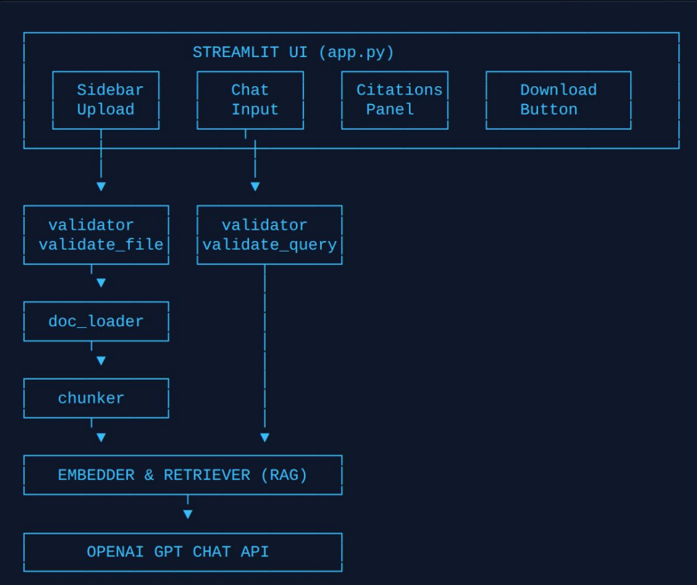
Python with Data Science Group -1
  System Architecture / Design
Dept. of AI&DS,SJCIT 2026 9

Slide 10
Python with Data Science Group -1
Methodology
Step 1: Setting the Foundation
  Set up a clean Python 3.10+ environment.
  Established the connection to OpenAI for AI power and Streamlit for the user interface.
Step 2: Smart Data Loading
  Created "parsers" to read text from different files like PDFs, Word docs, and CSV tables.
  Used Pandas to make sure data from spreadsheets was handled correctly.
Step 3: Breaking Down Documents (Chunking)
  Used Tiktoken to cut long documents into smaller, exact pieces called "chunks".
  This ensures the AI never gets "overwhelmed" by too much text at once.
Step 4: The Search Engine (RAG)
  Turned text chunks into mathematical "vectors" using OpenAI Embeddings.
  Used Scikit-learn to quickly find which part of the document matches the user's question.
Step 5: Generating the Answer
  Sent only the most relevant document parts to the GPT model.
  Added a Citation System so the chatbot tells the user exactly which page or chunk the answer came from.
Dept. of AI&DS,SJCIT 2026 10

Slide 11
Python with Data Science Group -1
Implementation
Step 1: Building the Interface
  Used Streamlit to create a simple web page where users can upload files and chat with the AI.
Step 2: Processing Documents
  Integrated PyPDF2 and python-docx to "read" text from PDFs and Word documents automatically.
Step 3: Creating the Search Index
  Used Scikit-learn to build a fast search system that finds the right information in a split second.
Step 4: Connecting the AI
  Linked the OpenAI API to the backend so the chatbot can "understand" questions and give human-like answers
Step 5: Testing and Quality
  Applied Pytest to run automatic checks, making sure the code doesn't crash when a user uploads a weird or empty file.
Dept. of AI&DS,SJCIT 2026 11

Slide 12
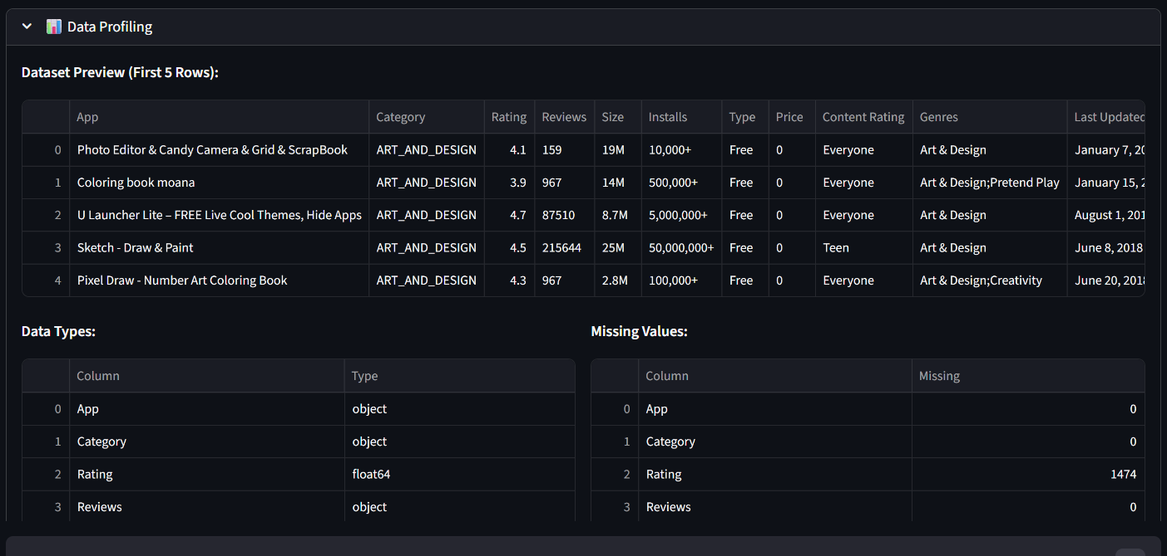
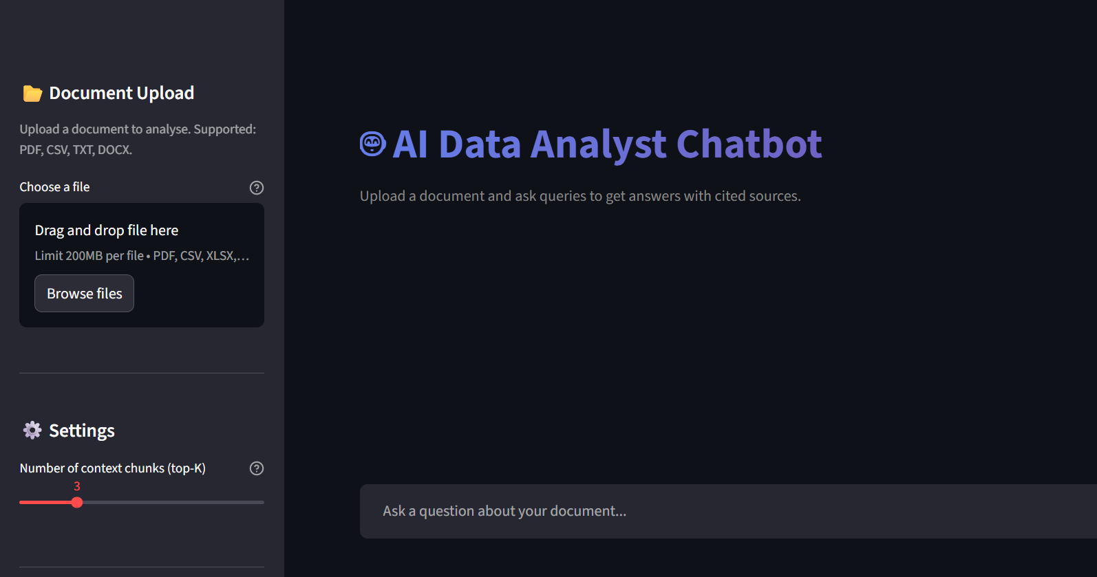
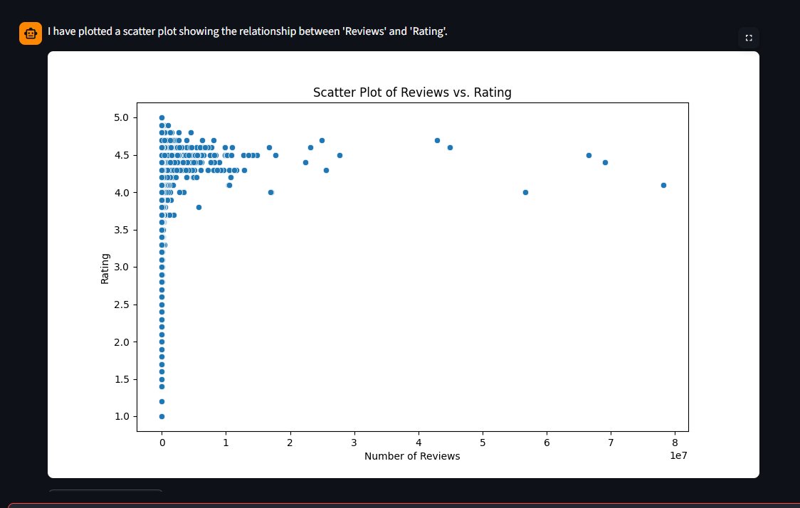
Python with Data Science Group -1
Results & Outcomes
Dept. of AI&DS,SJCIT 2026 12

Slide 13
Python with Data Science Group -1
Project Conclusion:
  Successful Development: Built a lightweight, high-accuracy AI Data Analyst Chatbot using a custom RAG pipeline.
  Data Reliability: Eliminated AI hallucinations by implementing a strict source-citation system.
  Efficiency: Proved that a modular approach using Python, Tiktoken, and Scikit-learn is faster and more transparent than using heavy frameworks.
Internship Conclusion:
  Skill Mastery: Gained professional-level proficiency in Python (3.10+), vector embeddings, and semantic search logic.
  Industry Readiness: Successfully bridged the gap between academic theory at SJCIT and real-world AI development requirements.
  Hands-on Impact: The 4-month duration at PySpiders provided deep exposure to the full Data Science life cycle, from document parsing to building interactive user interfaces.
Dept. of AI&DS, SJCIT 2026 13

Slide 14
Python with Data Science Group -1
Future Work
Live Database Integration: Transition from static file uploads (PDF/CSV) to connecting the chatbot directly to live SQL or NoSQL databases for real-time data analysis.
Voice-Enabled Interaction: Integrate speech-to-text and text-to-speech capabilities to allow users to interact with the data assistant using voice commands.
Multi-File Comparative Analytics: Develop features that allow the AI to compare data across multiple documents simultaneously, such as analyzing year-over-year financial reports.
On-Premise Privacy Support: Implement local Large Language Models (LLMs) to enable private data processing for sensitive corporate information without relying on external APIs.
Advanced Data Visualization: Enhance the chatbot's ability to automatically generate and display complex, interactive charts (like heatmaps or 3D scatter plots) directly in the Streamlit UI.
Dept. of AI&DS,SJCIT 2026 14

Slide 15
Python with Data Science Group -1
Q & A
Thank You
Dept. of ISE,SJCIT 2026 <<Slide No.>>

